Slide 1
International Workshop on Collaboration between Material Scientists and Biologists
Marie Hubálek Kalbáčová
Department of Science and Research in Biomedical Applications

Slide 2

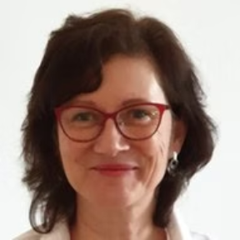
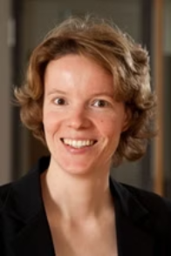
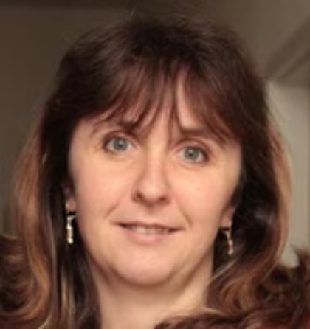
Partners
Researchers in biomedicine and biomaterials
Ms Dr.-Ing. Ute Bergmann
Ms PD Dr. Vera Hintze
ORCID: 0000-0002-8740-8310
ORCID: 0000-0002-5611-9903
Group Manager Corrosion and Surfaces, Institute of Materials Science, TU Dresden
Chair of Biomaterials, Center of Biomaterials, Institute of Materials Science, TU Dresden
Ms prof. RNDr. Marie Hubálek Kalbáčová, Ph.D.
Surface coatings with switchable surface changes for medical applications
Biometric coatings and hydrogel composites
ORCID: 0000-0002-3886-2218
PI and professor at the First Faculty of Medicine at Charles University
Group „Functional Biomaterials", Max Bergman
https://tu-dresden.de/ing/maschinenwesen/ifww/biomaterialien/forschung/korrosion-und-oberflaechen/Mitarbeitende/dr-ing-ute-bergmann
https://tu-dresden.de/ing/maschinenwesen/ifww/biomaterialien/forschung/funktionelle-biomaterialien/kontakt
Cell biology, cell interaction with nanomaterials (nanoparticles, nanostructured surfaces of implants or sensors), stem cells, immune cells
https://cuni.cz/UK-14182.html

Slide 3
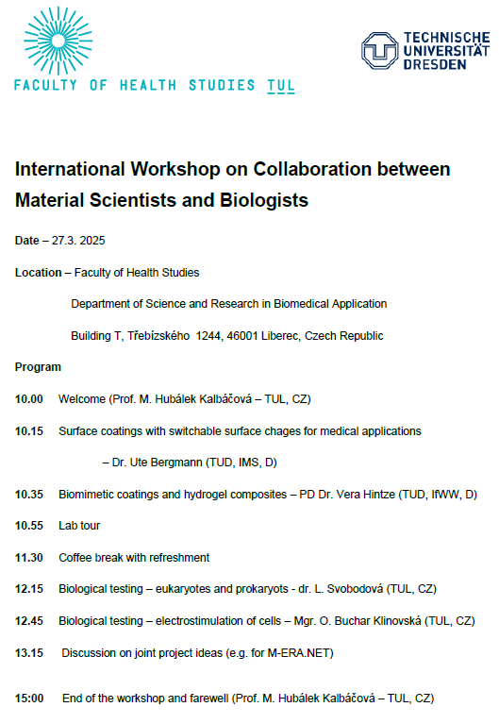
Partners:
Ph.D./Dr. Students, postdocs
Ms prof. RNDr. Marie Hubálek Kalbáčová, Ph.D.:
RNDr. Veronika Benson, Ph.D.
Mgr. Olga Buchar Klinovská
Ing. Lada Svobodová, Ph.D.
Ing. Iveta Zvercová, Ph.D.
Ms Dr.-Ing. Ute Bergmann:
Dipl.-Ing. Josephine Roth
Mr. Dipl. –Ing. Chenglin Li
Ms PD Dr. Vera Hintze:
Mr. Dr.-Ing. Poh Soo Lee
Jiaming Li

Slide 4
Programm:

Slide 5
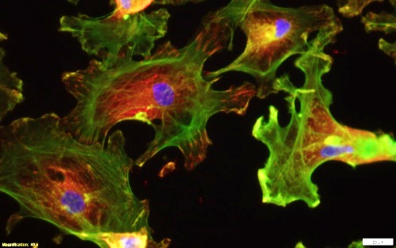
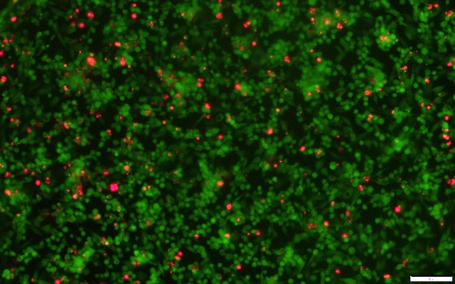
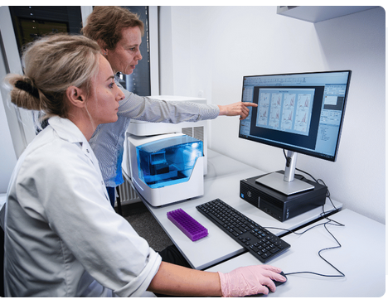
Department of Science and Research in Biomedical Applications
Different type of eukaryotic cells – different tissues – skin, bone, neurons,…
- different types – cell lines, primary cells, patient-derived cells
Different type of prokaryotic cells – different tissues – skin, bone,…
- different types – pathogens, commensals,
laboratory strains, patient-derived cells
Different methods – established or newly developed

Slide 6
Project:
M-ERA-NET
SIGMA Programme

Slide 7

Thank You for Your Attention

